Slide 1
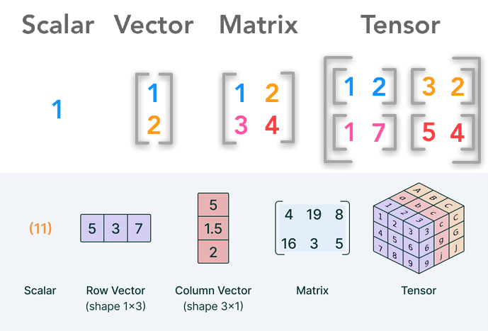
Tensor Operations: Moving Beyond NumPy
Tensors are the fundamental data structure in deep learning, similar to NumPy arrays but with specialized capabilities.
Deep learning frameworks allow for efficient management of memory between the CPU and GPU (CUDA).
Moving computations to the GPU provides the massive parallelization needed for training large models.

Slide 2
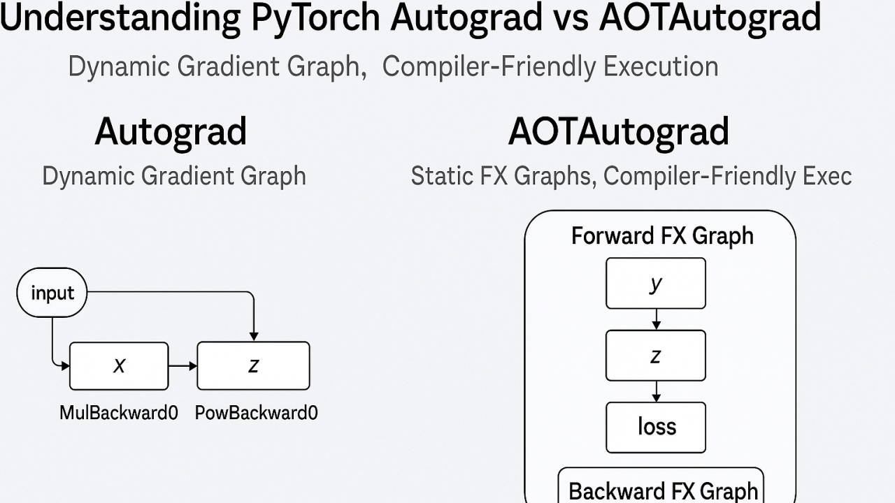
Autograd: The Engine of Learning
PyTorch is our primary framework for tracking mathematical operations.
Autograd automatically calculates the gradients (derivatives) required for backpropagation.
By tracking every operation, the framework can automatically calculate how to update weights without manual calculus.

Slide 3
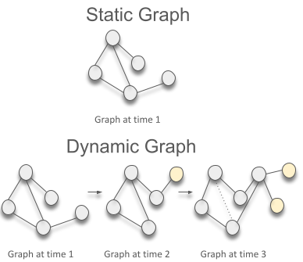
Computational Graphs: Static vs. Dynamic
A computational graph is a directed graph where nodes are operations and edges are tensors.
Static Graphs: The graph is defined and compiled once (common in older TensorFlow).
Dynamic Graphs: PyTorch builds the graph "on the fly" during execution, making debugging much easier and logic more flexible.

